Slide 1
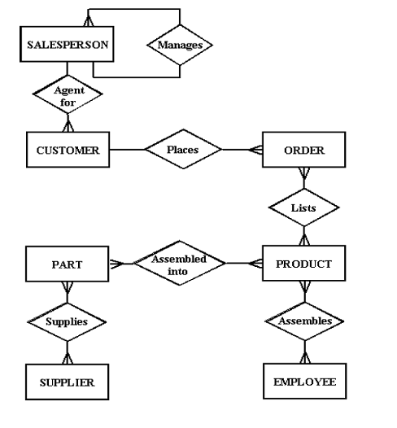
Example 1:
A salesperson may manage many other salespeople. A salesperson is managed by only one salespeople. A salesperson can be an agent for many customers. A customer is managed by one salespeople.
A customer can place many orders. An order can be placed by one customer.
An order lists many products. A product may be listed on many orders. A product is assembled from many parts. A part may be assembled into many products. Many employees assemble an products from many parts. A supplier supplies many parts. A part may be supplied by many suppliers.

Slide 2
Example 2:
Consider the following set of requirements for a university database that is used to keep track of students transcripts. a. The university keeps track of each student's name, student number, social security number, current address and phone, permanent address and phone, birthdate, sex, class (freshman, sophomore, ..., graduate), major department, minor department (if any), and degree program (B.A., B.S., ..., Ph.D.). Some user applications need to refer to the city, state, and zip of the student's permanent address, and to the students' last name. Both social security number and student number have unique values for each student. b. Each department is described by a name, department code, office number, office phone and college. Both name and code have unique values for each department. c. Each course has a course name, description, code number, number of semester hours, level, and offering department. The value of code number is unique for each course. d. Each section has an instructor, semester, year, course, and section number. The section number distinguishes different sections of the same course that are taught during the same semester/year; its values are 1, 2, 3, ...; up to the number of sections taught during each semester. e. A grade report has a student, section, and grade. Design an ER schema for this application, and draw an ER diagram for that schema. Specify key attributes of each entity type and structural constraints on each relationship type. Note any specified requirements, and make appropriate assumptions to make the specification complete.

Slide 3
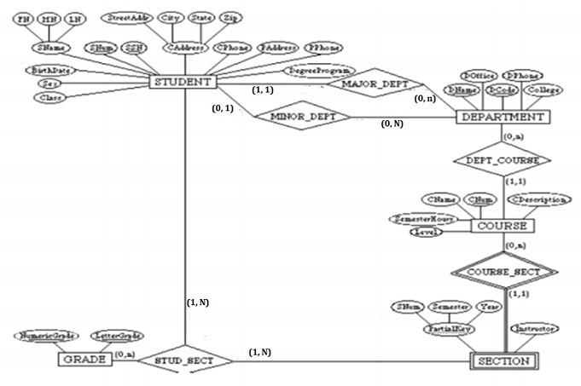

Slide 4
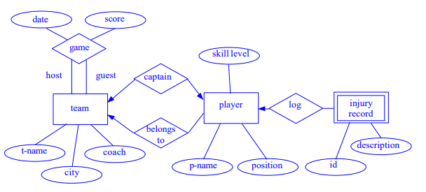
Example 3:
Suppose you are given the following requirements for a simple database for the National Hockey League (NHL):
• the NHL has many teams,
• each team has a name, a city, a coach, a captain, and a set of players,
• each player belongs to only one team,
• each player has a name, a position (such as left wing or goalie), a skill level, and a set of injury records,
• a team captain is also a player,
• a game is played between two teams (referred to as host_team and guest_team) and has a date (such as May 11th, 2017) and a score (such as 4 to 2).
Construct a clean and concise ER diagram for the NHL database

